Slide 1
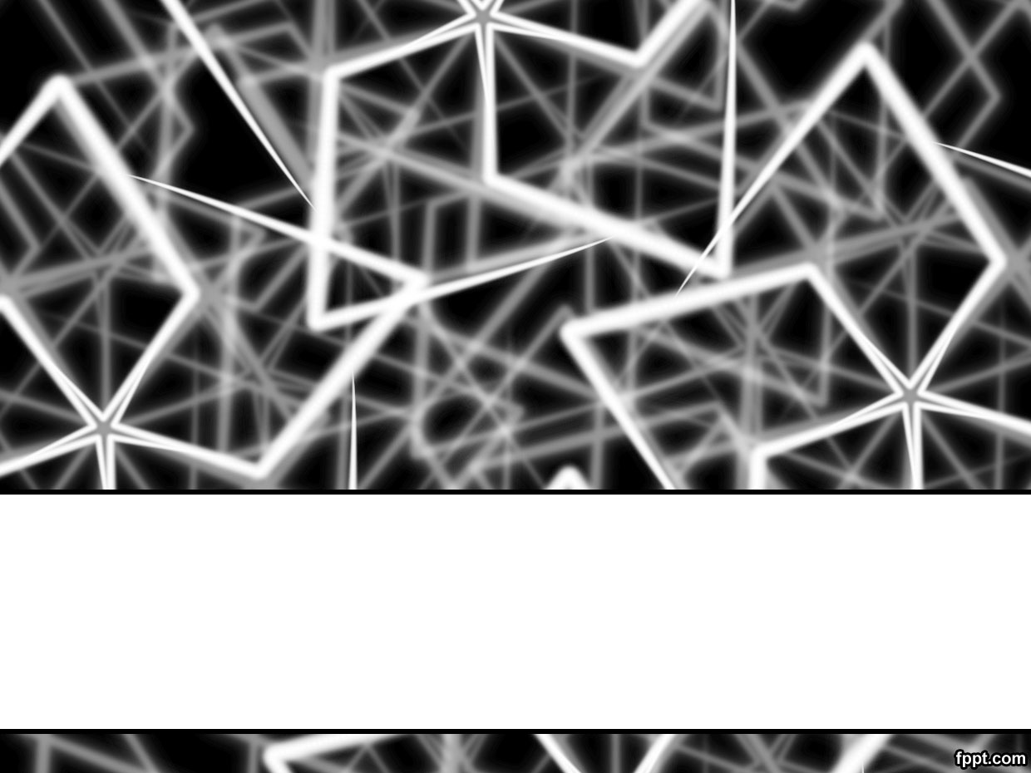
Lecture # 16
Computation Tree Logic - II

Slide 2
Algorithms for CTL

Slide 3
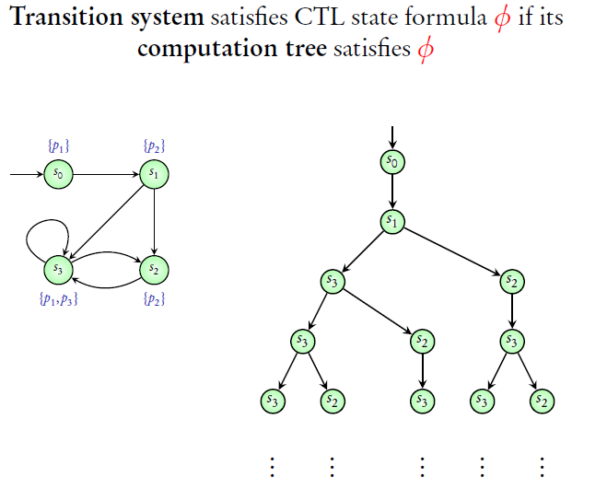
Computation Tree Logic (CTL)

Slide 4
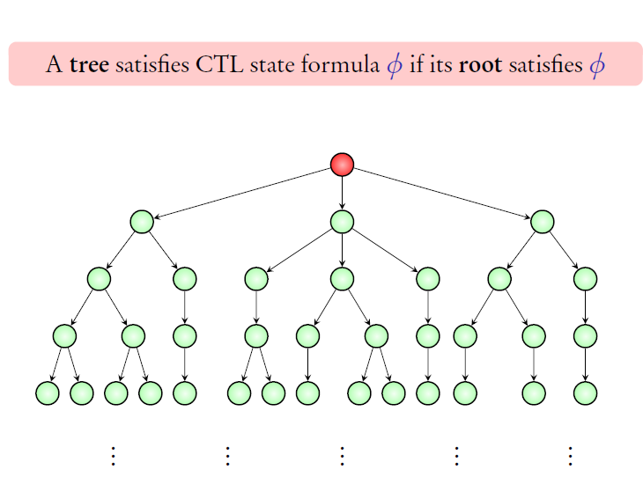
Computation Tree Logic (CTL)

Slide 5
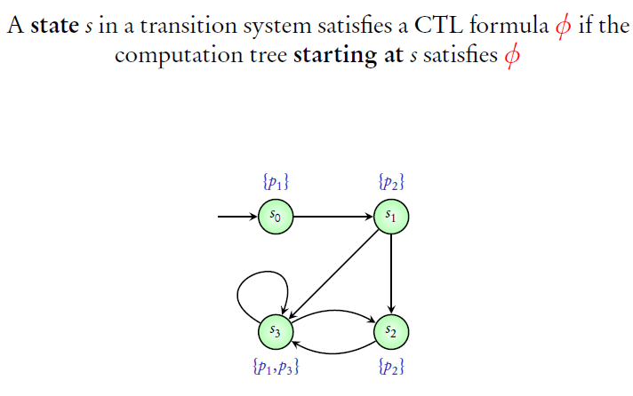
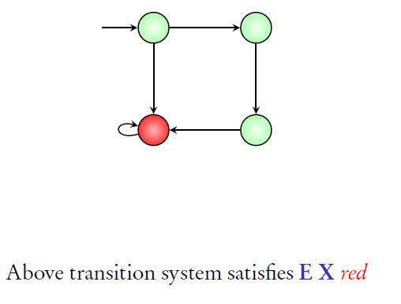
Computation Tree Logic (CTL)

Slide 6
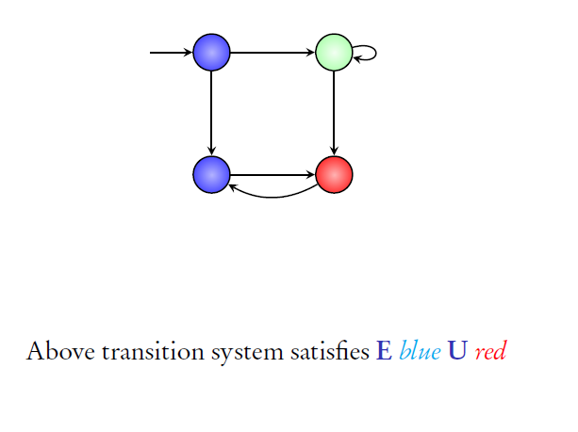
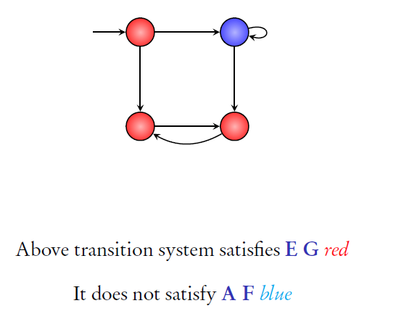
Computation Tree Logic (CTL)

Slide 7

CTL Model-Checking Problem

Slide 8
Part 1: Algorithm for E X

Slide 9




E X (p₁ ∧ p₂)
{ }
{p₂}
s₁
s₂
CTL - Algorithm for E X
{p₁}
s₃
s₅
s₄
{p₁, p₂}
{p ,p }
1 2
5/16

Slide 10
E X (p₁ ∧ p₂)
{ }
{p₂}
s₁
s₂
CTL - Algorithm for E X
{p₁}
s₃
s₅
s₄
{p₁, p₂}
p₁ ∧ p₂
{p , p }
1 2
p₁ ∧ p₂
5/16

Slide 11
E X (p₁ ∧ p₂)
E X (p₁ ∧ p₂)
{ }
{p₂}
s₁
s₂
CTL - Algorithm for E X
{p₁}
s₃
s₅
s₄
{p₁, p₂}
p₁ ∧ p₂
{p , p }
1 2
p₁ ∧ p₂
5/16

Slide 12
E X (p₁ ∧ p₂)
E X (p₁ ∧ p₂)
{ }
{p₂}
s₁
s₂
CTL - Algorithm for E X
{p₁}
s₃
s₅
s₄
{p₁, p₂}
{p , p }
p₁ ∧ p₂
1 2
p₁ ∧ p₂
E X (p₁ ∧ p₂)
5/16

Slide 13
E X (p₁ ∧ p₂)
E X (p₁ ∧ p₂)
E X (p₁ ∧ p₂)
{ }
{p₂}
s₁
s₂
CTL - Algorithm for E X
{p₁}
s₃
s₅
s₄
{p₁, p₂}
{p , p }
p₁ ∧ p₂
1 2
p₁ ∧ p₂
E X (p₁ ∧ p₂)
5/16

Slide 14




E X (p₁ ∧ ¬p₂)
{p₂}
s₂
CTL - Algorithm for E X
{} s₁
s₄
{p₁}
s₃
{p₁, p₂}
6/16

Slide 15
E X (p₁ ∧ ¬p₂)
{p₂}
s₂
CTL - Algorithm for E X
{} s₁
{p₁}
p₁ ∧ ¬p₂
s₄
s₃
{p₁, p₂}
6/16

Slide 16
E X (p₁ ∧ ¬p₂)
{p₂}
s₂
CTL - Algorithm for E X
{} s₁
{p₁}
p₁ ∧ ¬p₂
s₄
s₃
{p₁, p₂}
E X (p₁ ∧ ¬p₂)
6/16

Slide 17
E X (p₁ ∧ ¬p₂)
E X (p₁ ∧ ¬p₂)
{p₂}
s₂
CTL - Algorithm for E X
{} s₁
{p₁}
p₁ ∧ ¬p₂
s₄
s₃
{p₁, p₂}
E X (p₁ ∧ ¬p₂)
6/16

Slide 18
E X (p₁ ∧ ¬p₂)
E X (p₁ ∧ ¬p₂)
{p₂}
s₂
CTL - Algorithm for E X
{} s₁
s₄
{p₁}
p₁ ∧ ¬p₂
E X (p₁ ∧ ¬p₂)
s
3
{p₁, p₂}
E X (p₁ ∧ ¬p₂)
6/16

Slide 19



Algorithm for E X φ
CTL - Algorithm for E X
s
7/16

Slide 20
Algorithm for E X φ
Suppose states satisfying φ have been labelled
CTL - Algorithm for E X
φ
s
7/16

Slide 21
Algorithm for E X φ
Suppose states satisfying φ have been labelled
φ
s
E X φ
CTL - Algorithm for E X
State s is labelled with E X φ if there exists a successor which is labelled φ
7/16

Slide 22
Part 2: Algorithm for E U

Slide 23





E (p₁ U p₂)
{p₁}
{p₁}
{p₁}
CTL - Algorithm for E U
s₁
s₂
s₃
s₆
{ }
s₄
{p₂}
s₅
{p₁}

Slide 24
E (p₁ U p₂)
{p₁}
{p₁}
{p₁}
CTL - Algorithm for E U
s₁
s₂
s₃
s₆
{ }
s₅
s₄
{p₂}
E p₁ U p₂
{p₁}
9/16

Slide 25
E (p₁ U p₂)
E p₁ U p₂
{p₁}
{p₁}
{p₁}
CTL - Algorithm for E U
s₁
s₂
s₃
s₆
{ }
s₅
s₄
{p₁}
{p₂}
E p₁ U p₂ E p₁ U p₂
9/16

Slide 26
E (p₁ U p₂)
E p₁ U p₂
E p₁ U p₂
{p₁}
{p₁}
{p₁}
CTL - Algorithm for E U
s₁
s₂
s₃
s₆
{ }
s₅
s₄
{p₁}
{p₂}
E p₁ U p₂ E p₁ U p₂
9/16

Slide 27
E (p₁ U p₂)
E p₁ U p₂
E p₁ U p₂
E p₁ U p₂
{p₁}
{p₁}
{p₁}
CTL - Algorithm for E U
s₁
s₂
s₃
s₆
{ }
s₅
s₄
{p₁}
{p₂}
E p₁ U p₂ E p₁ U p₂
9/16

Slide 28


E (¬ p₁ U ¬ p₂)
{p₂}
{ }
s₂
s₃
CTL - Algorithm for E U
{p₂}
s₁
s₄
{p₂}
s₆
{p₁}
s₅
{p₁}
10/16

Slide 29
E (¬ p₁ U ¬ p₂)
¬p₁
¬p₁, ¬p₂
{p₂}
{ }
¬p₁
{p₂}
s₂
s₃
CTL - Algorithm for E U
¬p₁
{p₂}
s₁
s₄
s₆
{p₁}
¬p₂
s₅
{p₁}
¬p₂
10/16

Slide 30
E (¬ p₁ U ¬ p₂)
E (¬p₁ U ¬p₂)
¬p₁, ¬p₂
¬p₁
{p₂}
{ }
¬p₁
{p₂}
s₂
s₃
CTL - Algorithm for E U
¬p₁
{p₂}
s₁
s₄
s₆
{p₁}
¬p₂
E (¬p₁ U ¬p₂)
s₅
{p₁}
¬p₂
E (¬p₁ U ¬p₂)
10/16

Slide 31
E (¬ p₁ U ¬ p₂)
E (¬p₁ U ¬p₂)
¬p₁
E (¬p₁ U ¬p₂)
¬p₁, ¬p₂
{p₂}
{ }
¬p₁
{p₂}
s₂
s₃
E (¬p₁ U ¬p₂)
¬p₁
CTL - Algorithm for E U
s₁
s₄
{p₂}
s₆
{p₁}
¬p₂
E (¬p₁ U ¬p₂)
s₅
{p₁}
¬p₂
E (¬p₁ U ¬p₂)
10/16

Slide 32
E (¬ p₁ U ¬ p₂)
E (¬p₁ U ¬p₂)
¬p₁
E (¬p₁ U ¬p₂)
¬p₁, ¬p₂
{p₂}
{ }
E (¬p U ¬p )
1 2
s₂
s₃
¬p₁
{p₂}
E (¬p₁ U ¬p₂)
¬p₁
CTL - Algorithm for E U
s₁
s₄
{p₂}
s₆
{p₁}
s₅
{p₁}
¬p₂
E (¬p₁ U ¬p₂)
¬p₂
E (¬p₁ U ¬p₂)
10/16

Slide 33


Algorithm for E (φ₁ U φ₂)
s
CTL - Algorithm for E U
⊃
⊃
If any state is labelled with φ₂, label it with E (φ₁ U φ₂)
Repeat:
Label any state with E (φ₁ U φ₂)if it is labelled with φ₁ and at least one successor is labelled with E (φ₁ U φ₂)
until no change
11/16

Slide 34
Algorithm for E (φ₁ U φ₂)
E (φ₁ U φ₂)
φ₁
s
CTL - Algorithm for E U
⊃
⊃
If any state is labelled with φ₂, label it with E (φ₁ U φ₂)
Repeat:
Label any state with E (φ₁ U φ₂)if it is labelled with φ₁ and at least one successor is labelled with E (φ₁ U φ₂)
until no change
11/16

Slide 35
Algorithm for E (φ₁ U φ₂)
E (φ₁ U φ₂)
E (φ₁ U φ₂)
φ₁
s
CTL - Algorithm for E U
⊃
⊃
If any state is labelled with φ₂, label it with E (φ₁ U φ₂)
Repeat:
Label any state with E (φ₁ U φ₂)if it is labelled with φ₁ and at least one successor is labelled with E (φ₁ U φ₂) until no change
11/16

Slide 36
Part 3: Algorithm for E G

Slide 37







E G p₁
{p₁}
{p₁}
{p₁}
{ }
s₁
s₂
s₃
s₄
CTL - Algorithm for E G
s₅
{ }
s₈
s₇
s₆
{p₁}
{p₁}
{p₁}
13/16

Slide 38
E G p₁
E G p₁
E G p₁
E G p₁
E G p₁
{p₁}
{p₁}
{p₁}
{ }
s₁
s₂
s₃
s₄
CTL - Algorithm for E G
s₈
s₇
s₆
s₅
{p₁}
E G p₁
{p₁}
E G p₁
{p₁}
E G p₁
{ }
E G p₁
13/16

Slide 39
E G p₁
E G p₁
E G p₁
E G p₁
{p₁}
{p₁}
{p₁}
{ }
s₁
s₂
s₃
s₄
CTL - Algorithm for E G
s₅
{ }
s₈
s₇
s₆
{p₁}
{p₁}
{p₁}
E G p₁
E G p₁
E G p₁
13/16

Slide 40
E G p₁
E G p₁
E G p₁
E G p₁
{p₁}
{p₁}
{p₁}
{ }
s₁
s₂
s₃
s₄
CTL - Algorithm for E G
s₅
{ }
s₈
s₇
s₆
{p₁}
E G p₁
{p₁}
E G p₁
{p₁}
13/16

Slide 41
E G p₁
E G p₁
E G p₁
{p₁}
{p₁}
{p₁}
{ }
s₁
s₂
s₃
s₄
CTL - Algorithm for E G
s₅
{ }
s₈
s₇
s₆
{p₁}
E G p₁
{p₁}
{p₁}
13/16

Slide 42
E G p₁
E G p₁
{p₁}
{p₁}
{p₁}
{ }
s₁
s₂
s₃
s₄
CTL - Algorithm for E G
s₅
{ }
s₈
s₇
s₆
{p₁}
{p₁}
{p₁}
13/16

Slide 43
E G p₁
{p₁}
{p₁}
{p₁}
{ }
s₁
s₂
s₃
s₄
CTL - Algorithm for E G
s₅
{ }
s₈
s₇
s₆
{p₁}
{p₁}
{p₁}
13/16

Slide 44
E G p₁
{p₁}
{p₁}
{p₁}
{ }
s₁
s₂
s₃
s₄
CTL - Algorithm for E G
s₅
{ }
s₈
s₇
s₆
{p₁}
{p₁}
{p₁}
No state of the above transition system satisfies E G p₁
13/16

Slide 45
E G p₁
{p₁}
{p₁}
{p₂}
s₆
s₁
s₂
CTL - Algorithm for E G
s₄
{ }
s₃
{p₁}
s₅
{p₁}
14/16

Slide 46
E G p₁
E G p₁
E G p₁
E G p₁
{p₁}
{p₁}
{p₂}
s₆
s₁
s₂
CTL - Algorithm for E G
s₅
{p₁}
E G p₁
s₄
{ }
E G p₁
s₃
{p₁}
E G p₁
14/16

Slide 47
E G p₁
E G p₁
E G p₁
{p₁}
{p₁}
{p₂}
s₆
s₁
s₂
CTL - Algorithm for E G
s₄
{ }
s₅
s₃
{p₁}
E G p₁
{p₁}
E G p₁
14/16

Slide 48
E G p₁
E G p₁
E G p₁
{p₁}
{p₁}
{p₂}
s₆
s₁
s₂
CTL - Algorithm for E G
s₄
{ }
s₃
{p₁}
s₅
{p₁}
E G p₁
14/16

Slide 49
Algorithm for E G φ
CTL - Algorithm for E G
15/16

Slide 50
Algorithm for E G φ
⊃ Label all states with E G φ
CTL - Algorithm for E G
15/16

Slide 51
Algorithm for E G φ
⊃ Label all states with E G φ
⊃ If any state is not labelled with φ, delete the label E G φ
CTL - Algorithm for E G
15/16

Slide 52
Algorithm for E G φ
⊃ Label all states with E G φ
⊃ If any state is not labelled with φ, delete the label E G φ
CTL - Algorithm for E G
⊃
Repeat:
Delete the label E G φ from a state if none of its successors is labelled with E G φ
until no change
15/16

Slide 53

Algorithm for E G φ
⊃ Label all states with E G φ
⊃ If any state is not labelled with φ, delete the label E G φ
E G φ
CTL - Algorithm for E G
E G φ s
E G φ
E G φ
⊃
Repeat:
Delete the label E G φ from a state if none of its successors is labelled with E G φ
until no change
15/16

Slide 54
Algorithm for E G φ
⊃ Label all states with E G φ
⊃ If any state is not labelled with φ, delete the label E G φ
CTL - Algorithm for E G
E G φ s
⊃
Repeat:
Delete the label E G φ from a state if none of its successors is labelled with E G φ
until no change
15/16

Slide 55
Algorithm for E G φ
⊃ Label all states with E G φ
⊃ If any state is not labelled with φ, delete the label E G φ
CTL - Algorithm for E G
s
⊃
Repeat:
Delete the label E G φ from a state if none of its successors is labelled with E G φ
until no change
15/16

Slide 56
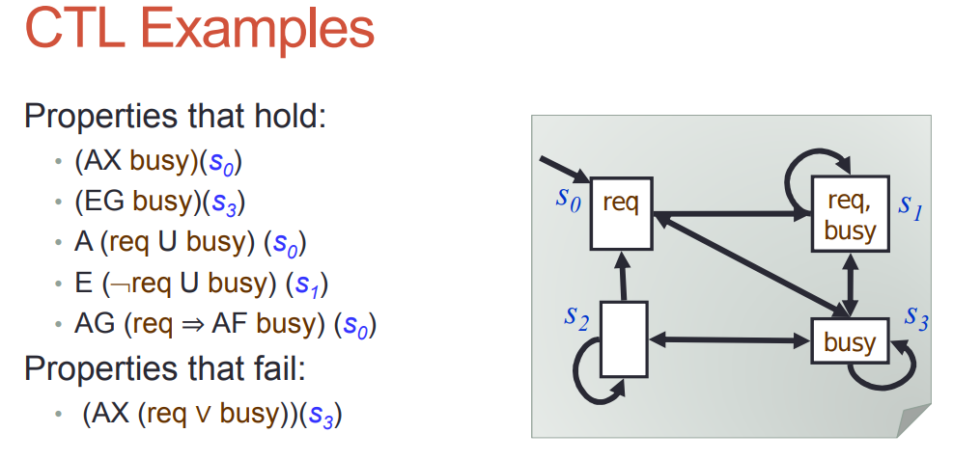
CTL EXAMPLE

Slide 57
Temporal Logic Gets Everywhere
specification and verification of (dynamic) programs
specification and verification of distributed and
concurrent programs
representation of tense in natural language
characterizing temporal database queries
verification of finite state models derived from ‘real’
systems (model checking)
agent theory
direct execution
real-time analysis
temporal data mining
exploring the limits of decidability
.......

Slide 58
REFERENCES :
Michael Huth, Mark Ryan-Cambridge, Logic in computer science_ modelling and reasoning about systems University Press (2004) - Chapter 5

